Slide 1


Slide 2
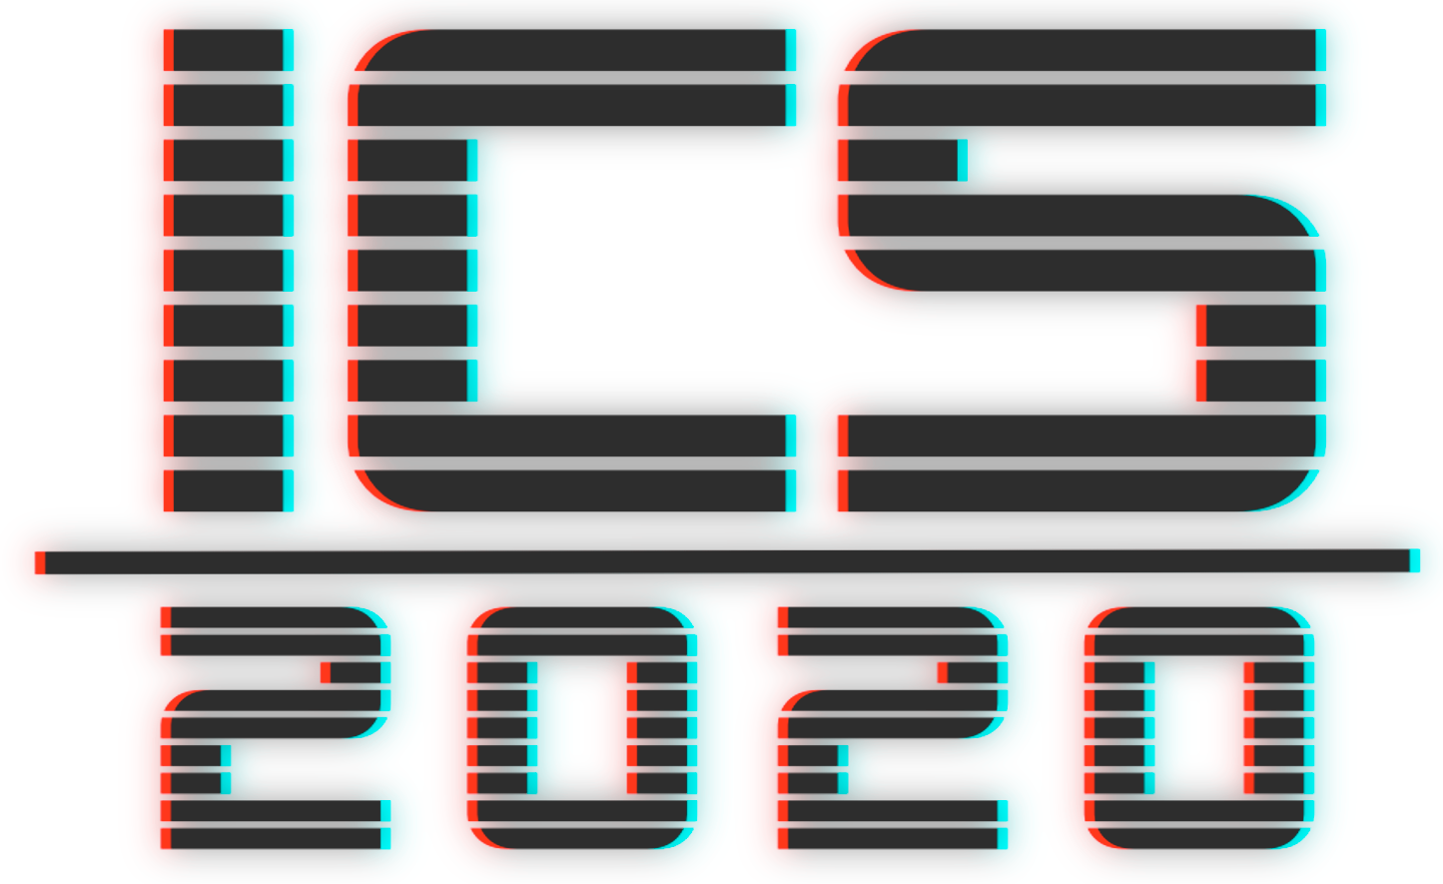
Why should you learn programming?
Becoming more efficient and productive
Understanding how software works
Combining technical skills with creativity
Enjoying more freedom and flexibility in life
Becoming aware of what it takes
Improving your problem solving and thinking skills
Improving your communication and collaboration skills
Becoming self-employed and starting your own business
Achieving a higher income
Having the self-learner’s advantage

Slide 3
What we’ll learn
Structure of the course
We will cover following topics:
Syntax
Files System
Version Control
Best Coding Practices
Variables
Python Objects (List, Dictionary, Tuple, Sequence, Set)
Control Flow (Boolean Expressions/Operators, If, Else, Else If)
Loops (For, While),
Functions
Classes
Matlab Introduction (optional)

Slide 4
Grading
Assignments
Short quizzes at the start of the class about previously discussed topics
Coding assignments at the class
Project made in groups -
30%
50%
20%

Slide 5
Final project criteria

Slide 6
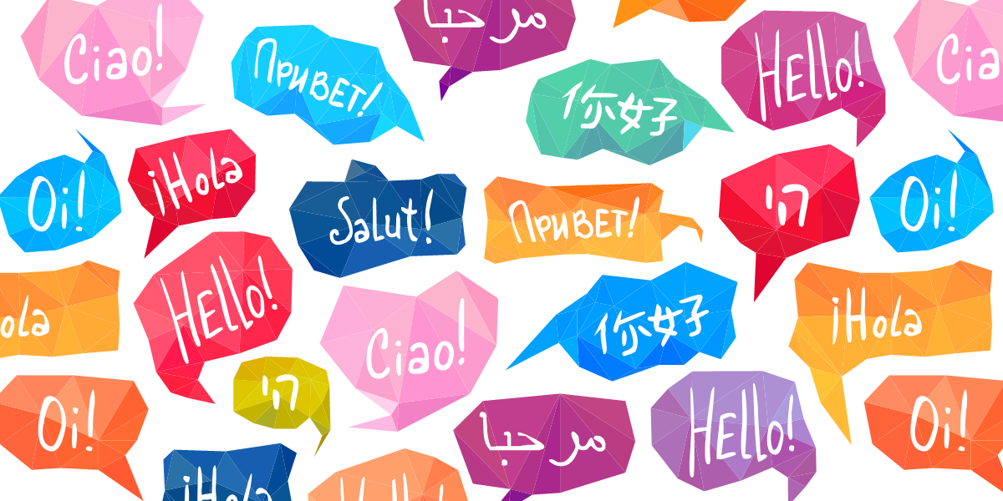
Let’s start from scratch
What is language?
The system of communication in speech and writing that is used by people of a particular country or area.

Slide 7

Let’s start from scratch
What is computer language?
The system of communication in speech and writing that is used by people of a particular country or area

Slide 8
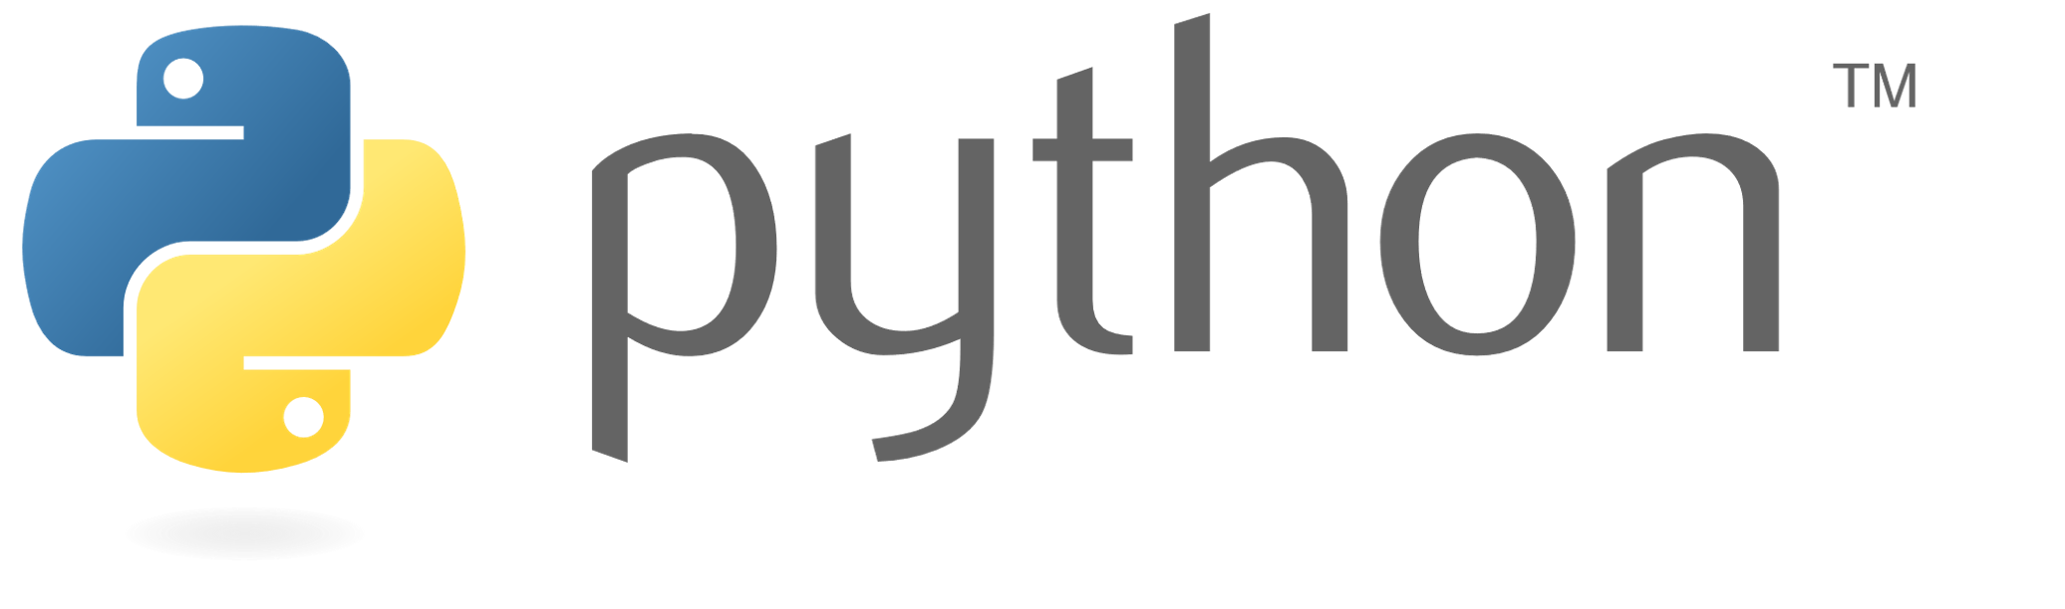
What is python?
Interpreted
Object oriented
is …
High-level
Dynamic

Slide 9

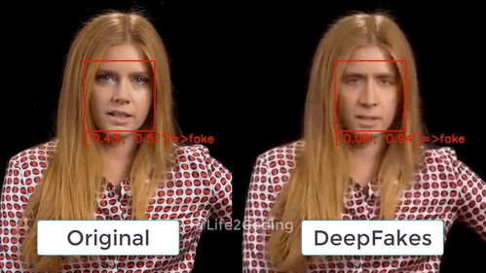
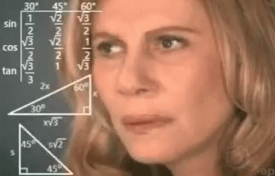
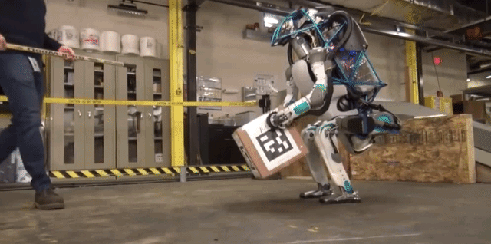
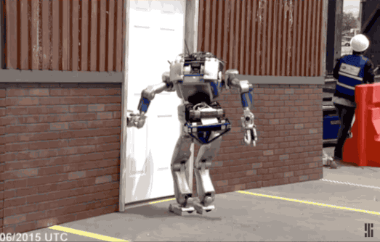
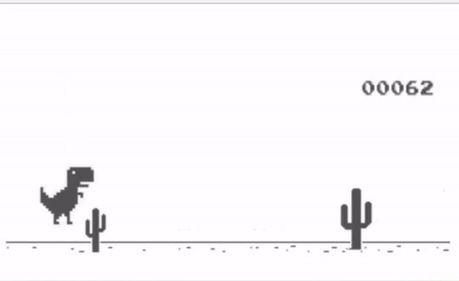
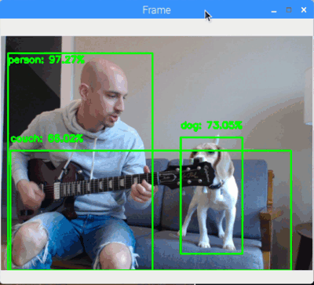
Where python is used?
Web development
Machine learning
Data science (analysis/visualization)
Robotics
Games (for easy ones)
Machine vision

